Slide 1

Breast Cancer Detection - Applied Machine Learning CS 3840
Matthew Slusser

Slide 2
Background
Goal: Predict whether the cancer is benign or malignant
Why: Cancer with the second highest annual death in women
How: Make predictions using various models to get the highest level of accuracy

Slide 3
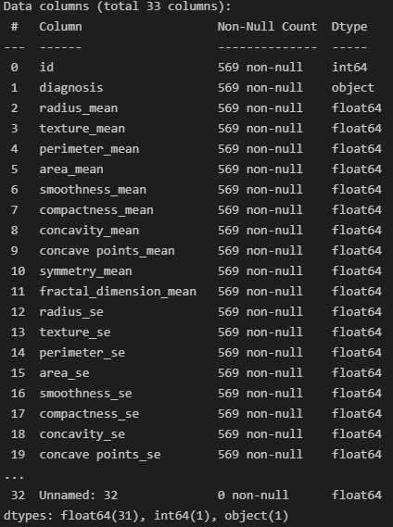
Dataset - Breast Cancer Wisconsin (Diagnostic) Data Set
Features are computed from a digitized image of a fine needle aspirate (FNA) of a breast mass. They describe characteristics of the cell nuclei present in the image.
Pre-processing consisted of dropping the id and Unnamed: 32, then picking the diagnosis as the label. Test size = 20%

Slide 4
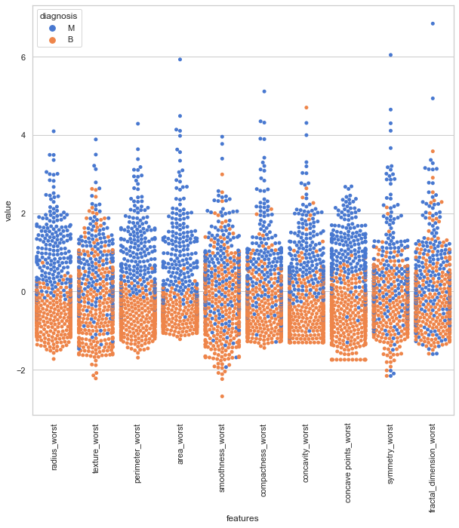
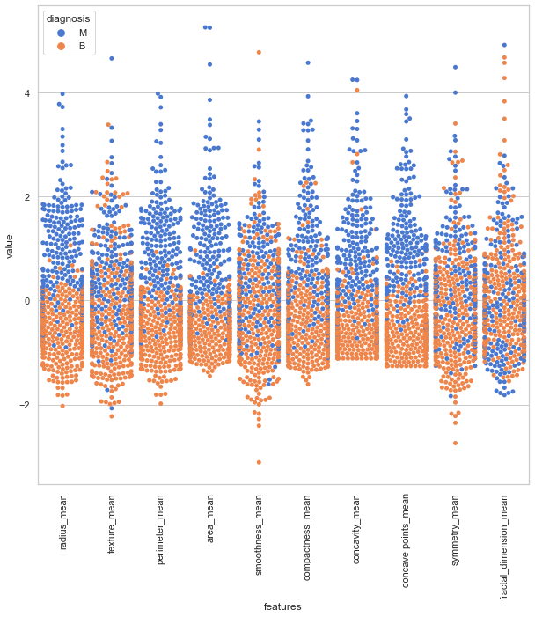
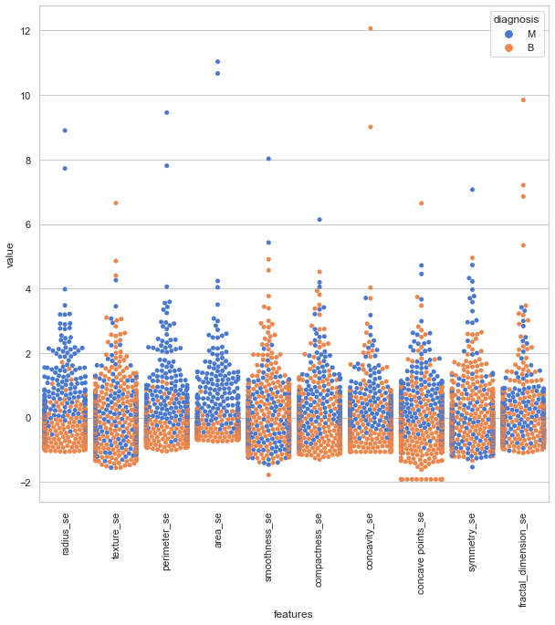
Visualizations

Slide 5
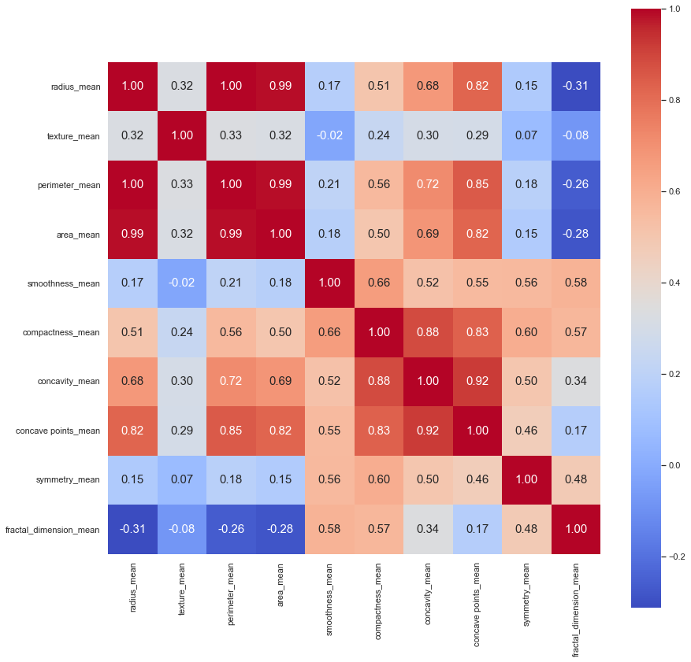
Correlation Matrix

Slide 6
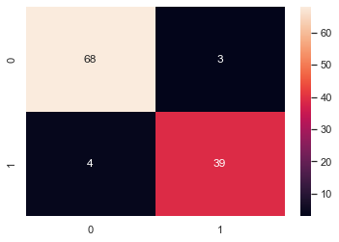
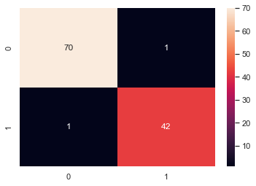
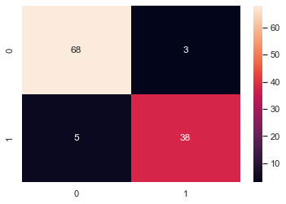
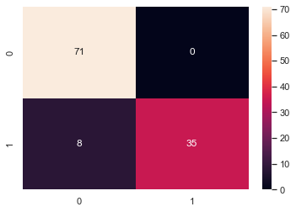
Methods
Random Forest:
Random Forest Accuracy: 0.98246
Logistic Regression:
Logistic Regression Accuracy: 0.93860
Logistic Regression F1-Score: 0.91765
K-Nearest Neighbrs:
K-nearest Neighbors Accuracy: 0.92982
K-nearest Neighbors F1-Score: 0.90476
Support Vector Machine:
SVM Accuracy: 0.92982
SVM F1-Score: 0.89744
Micro F1-Score: 0.92982
Macro F1-Score: 0.92205

Slide 7
Challenges and future steps
Challenges: My dataset is way too small and so I started to look for a larger dataset and unfortunately couldn’t find one that was not based on image classification which I didn’t have the time to implement
Future Step: Image classification with the CBIS-DDSM: Breast Cancer Image Dataset
Number of Studies: 6775
Number of Series: 6775
Number of Participants: 1,566
Number of Images: 10239

Slide 8
Q&A

